Slide 1

Heredity and Evolution
Sex determination

Slide 2
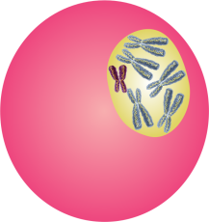
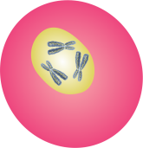
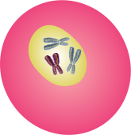
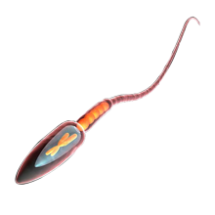
Sex Determination
46 Chromosomes
22 pairs - Autosomes
1 pair - Sex Chromosome
Male
Reductional Division
22 + X
22 + Y
Mitotic Division
22 + X
22 + Y

Slide 3
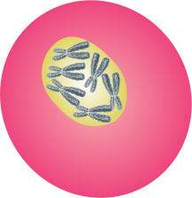

Sex Determination
46 Chromosomes
22 pairs - Autosomes
1 pair - Sex Chromosome
Male
Female
Reductional Division
22 + X
22 + Y
22 + X
22 + X
Mitotic Division
22 + X
22 + Y
22 + X

Slide 4
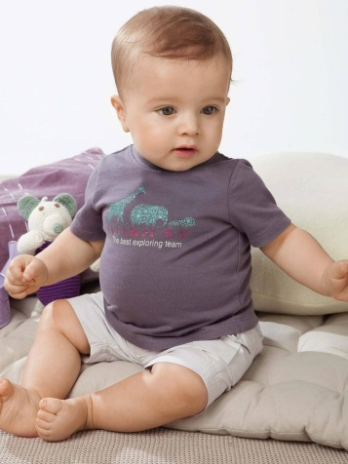
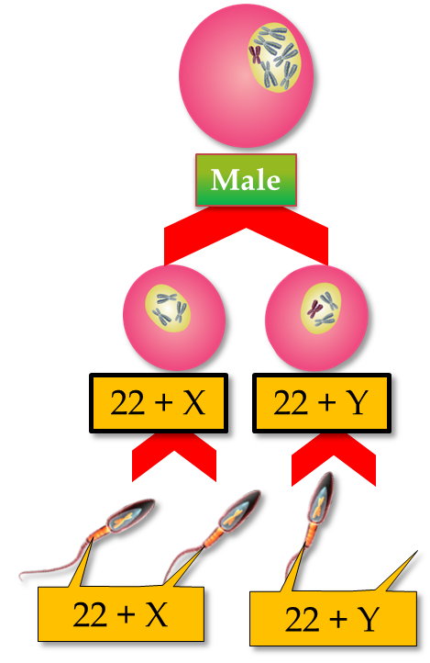
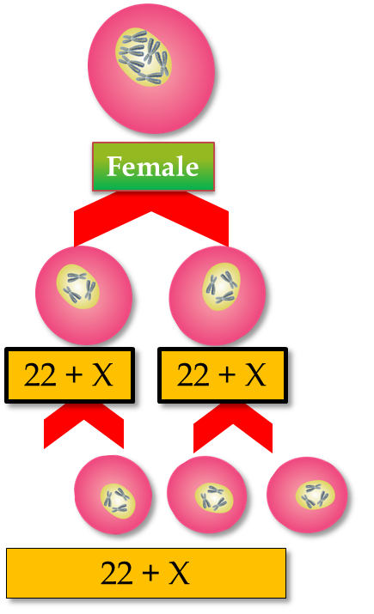
Sex Determination
Male Child

Slide 5
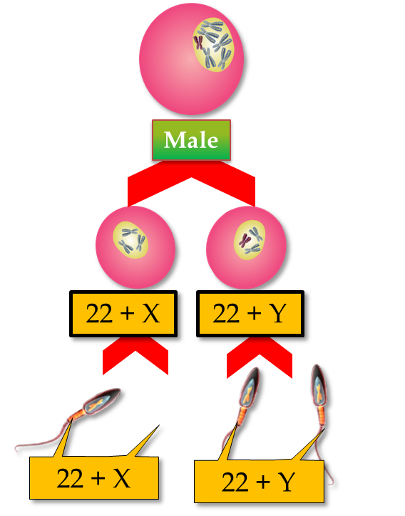

Sex Determination
Female Child

Slide 6
Thank You

